Slide 1
CSE 2202 Design and Analysis of Algorithms – I Lecture 5: Applications of DFS:
Articulation Points, Biconnected Components and Bridge

Slide 2
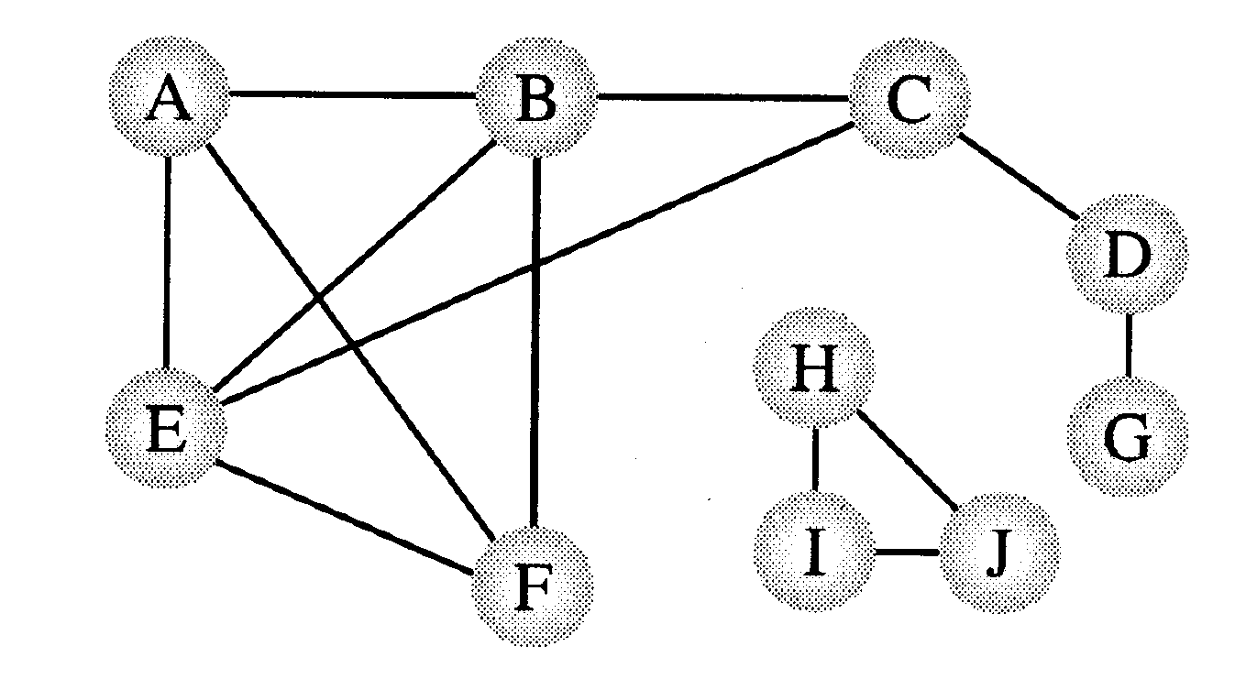
Connectivity/Biconnectivity for Undirected Graph
A node and all the nodes reachable from it compose a connected component.
A graph is called connected if it has only one connected component.
Since the function visit() of DFS visits every node that is reachable and has not already been visited, the DFS can easily be modified to print out the connected components of a graph.
Two connected components

Slide 3
Connectivity/Biconnectivity
In actual uses of graphs, such as networks, we need to establish not only that every node is connected to every other node, but also there are at least two independent paths between any two nodes.
A maximum set of nodes for which there are two different paths is called biconnected components.

Slide 4
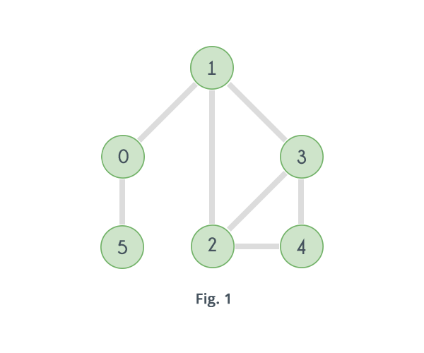
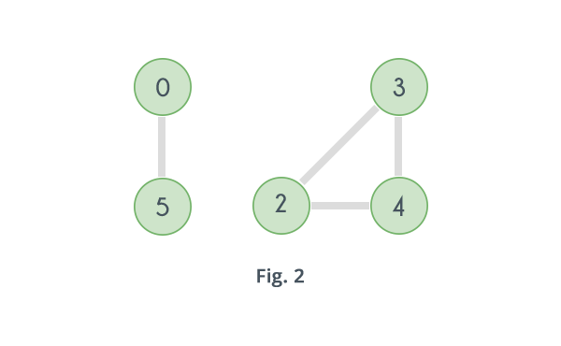
Connectivity/Biconnectivity for Undirected Graph

Slide 5
Connectivity/Biconnectivity
A graph is deemed biconnected if it meets the following criteria:
It exhibits connectivity, which means there is a simple path that allows for travel from any vertex to any other vertex within the graph.
The graph maintains its connectivity even when any single vertex is removed.
{H,I,J} and {A,B,C,E,F} are biconnected.

Slide 6
Connectivity/Biconnectivity
Another way to define this concept is that there are no single points of failure, that is -
no nodes that when deleted along with any adjoining arcs, would split the graph into two or more separate connected components.
Such a node is called an articulation point.
A graph is biconnected if it contains no articulation points.

Slide 7
Articulation Point
Let G = (V,E) be a connected undirected graph.
Articulation Point: is any vertex of G whose removal results in a disconnected graph.

Slide 8

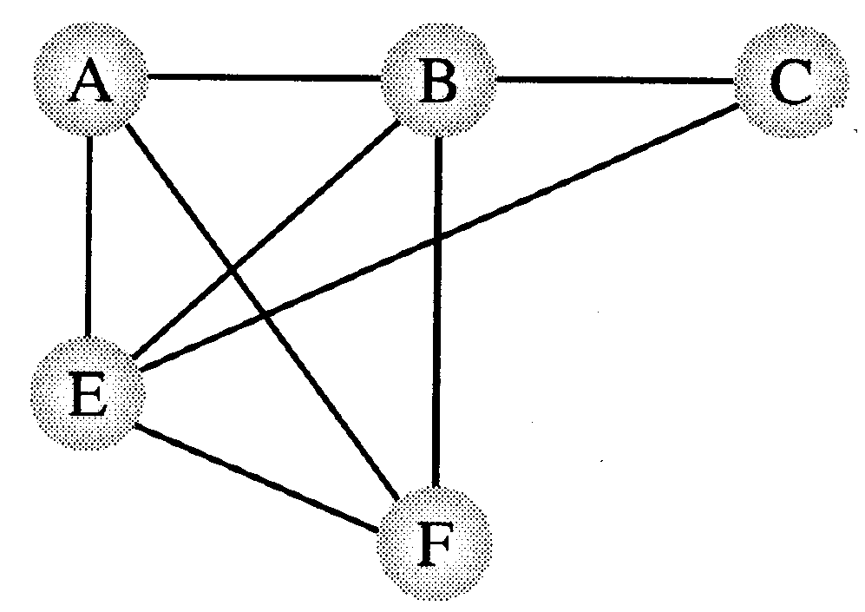
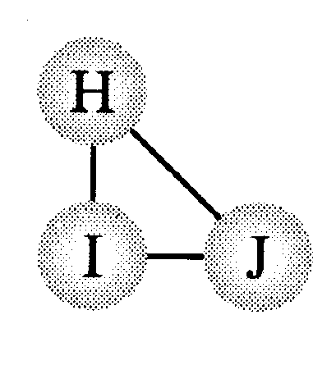
Biconnected components
If a graph contains no articulation points, then it is biconnected.
If a graph does contain articulation points, then it is useful to split the graph into the pieces where each piece is a maximal biconnected subgraph called a biconnected component.
Three biconnected components

Slide 9
Articulation points and DFS
How to find articulation points?
Use the tree structure provided by DFS
G is undirected: tree edges and back edges (no difference between forward and back edges, no cross edges)
Assume G is connected

Slide 10
internal vertex u
Consider an internal vertex u
Not a leaf,
Assume it is not the root
Let v1, v2,…, vk denote the children of u
Each is the root of a subtree of DFS
If for some child, there is no back edge from any node in this subtree going to a proper ancestor of u, then u is an articulation point
u
Here u is an articulation point

Slide 11
internal vertex u
Here u is not an articulation point
A back edge from every subtree of u to proper ancestors of u exists
u

Slide 12
What if u is a leaf
A leaf is never an articulation point
A leaf has no subtrees..

Slide 13
What about the root?
the root is an articulation point if and only if it has two or more children.
Root has no proper ancestor
There are no cross edges between its subtrees
This root is an articulation point

Slide 14
Finding Articulation Points
Problem:
Given any graph G = (V, E), find all the articulation points.
Possible strategy:
For all vertices v in V:
Remove v and its incident edges
Test connectivity using a DFS.
Execution time: Θ(n(n+m)).
Can we do better?

Slide 15
Finding Articulation Points
A DFS tree can be used to discover articulation points in Θ(n + m) time.

Slide 16
Finding Articulation Points
A DFS tree can be used to discover articulation points in Θ(n + m) time.
We start with a program that computes a DFS tree labeling the vertices with their discovery times.
We also compute a function called low(v) that can be used to characterize each vertex as an articulation or non-articulation point.
The root of the DFS tree will be treated as a special case:
The root has a d[] value of 1.

Slide 17
A
1
B
2
Assume that (a,b) ⇔ a → b
Tree edge : (a,b) a < b
Back edge : (a,b) a > b
9
3
D
C
F
4
E
6
w’
v
If there is a back edge from x
to a proper ancestor of v,
then v is reachable from x.
w
x

Slide 18
How to find articulation points?
Keep track of all back edges from each subtree?
Too expensive
Keep track of the back edge that goes highest in the tree (closest to the root)
If any back edge goes to an ancestor of u, this one will.
What is closest to root?
Smallest discovery time

Slide 19
Definition of low(v)
Definition. The value of low(v) is the discovery time of the vertex closest to the root and reachable from v by following zero or more tree edges downward, and then at most one back edge.
We can efficiently compute low by performing a postorder traversal of the depth-first spanning tree.
low[v] = min{
d[v],
lowest d[w] among all back edges (v, w)
lowest low[w] among all tree edges (v, w)
}
low(v) < d[v] indicates if there is another way to reach v which is not via its parent

Slide 20
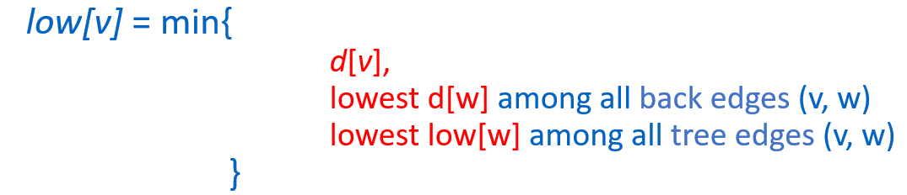
Low(v)
Observe that if there is a back edge from somewhere below v to above v in the tree, then low(v) < d[v]
Otherwise low(v) = d[v]
v
w

Slide 21
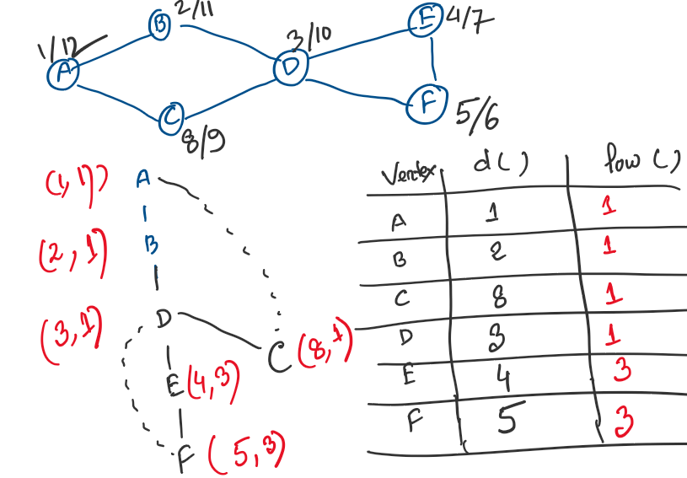
Low(v)

Slide 22
Computing Low[u]
Initialization:
Low[u] = d[u]
When a new back edge (u, v) is detected:
Low[u] = min( Low[u], d[v])
Tree edge (u, v):
Low[u] = min(Low[u], Low[v])

Slide 23
Finding Articulation Points
Once Low[v] is computed for all vertices v, we can test whether a nonroot vertex v is an articulation point
Let v be a non-root vertex of the DFS tree T.
Then v is an articulation point of G if and only if
there is a child w of v with low(w) >= d[v].

Slide 24
Articulation Points: Pseudocode
Data: color[V], time, prev[V],d[V], f[V], low[V]
DFS(G) // where prog starts
{
for each vertex u ∈ V
{
color[u] = WHITE;
prev[u]=NIL;
low[u]=inf;
f[u]=inf; d[u]=inf;
}
time = 0;
for each vertex u ∈ V
if (color[u] == WHITE)
DFS_Visit(u);
}

Slide 25
Articulation Points: Pseudocode
DFS_Visit(v)
{ color[v]=GREY;time=time+1;d[v] = time;
low[v]= d[v];
for each w ∈ Adj[v]{
if(color[w] == WHITE){
prev[w]=u;
DFS_Visit(w);
if low[w] >= d[v]
record that vertex v is an articulation
if (low[w] < low[v]) low[v] := low[w];
}
else if w is not the parent of v then
//--- (v,w) is a BACK edge
` if (d[w] < low[v]) low[v] := d[w];
}
color[v] = BLACK; time = time+1; f[v] = time;
}

Slide 26
findArticPts(u) //vertex u is just discovered
color[u] = gray
Low[u] = d[u] = ++time
for each (v in Adj[u]) do {
if (color[v] == white) then { //(u, v) is a tree edge
pred[v] = u
findArticPts(v)
Low[u] = min(Low[u], Low[v]) //update Low[u]
if (pred[u] == NIL) {//u is root
(if v is u’s second child)
add u to set of articulation points
}
else if (Low[v] >= d[u]) // if there is no back edge to an ancestor of u
add u to set of articulation points
}
else if (v != pred[u]) //(u, v) is a back edge
Low[u] = min(Low[u], d[v]) //this back edge goes closer to the root
}

Slide 27
a
e
i
d=1
Low = 1
a
2
b
1
8
e
8
b
f
j
3
c
1
9
i
8
c
g
10
4
d
7
f
1
j
8
d
h
3
5
h
3
6
g
3

Slide 28
Special Case
When “v” is a root of the DFS tree, you have to check it manually.

Slide 29
Finding Articulation Points
The root of the DFS tree is an articulation point if and only if it has two or more children.
Suppose the root has two or more children.
Recall that back edges never link vertices between two different subtrees.
So, the subtrees are only linked through the root vertex and its removal will cause two or more connected components (i.e. the root is an articulation point).
Suppose the root is an articulation point.
This means that its removal would produce two or more connected components each previously connected to this root vertex.
So, the root has two or more children.

Slide 30
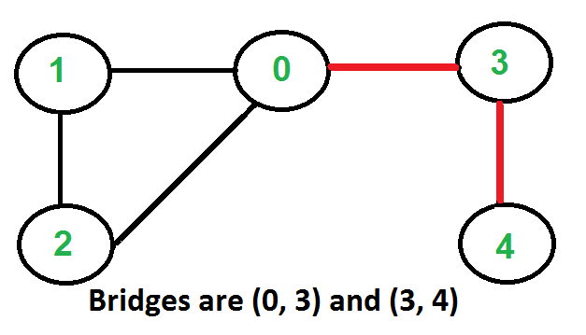
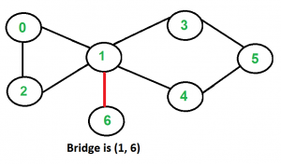
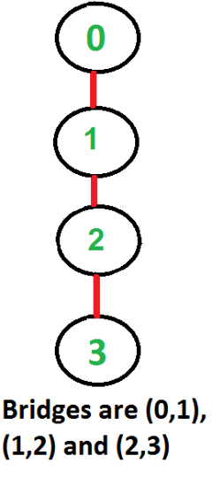
Bridge
An edge in an undirected connected graph is a bridge iff removing it disconnects the graph.
For a disconnected undirected graph, definition is similar, a bridge is an edge removing which increases number of disconnected components.

Slide 31
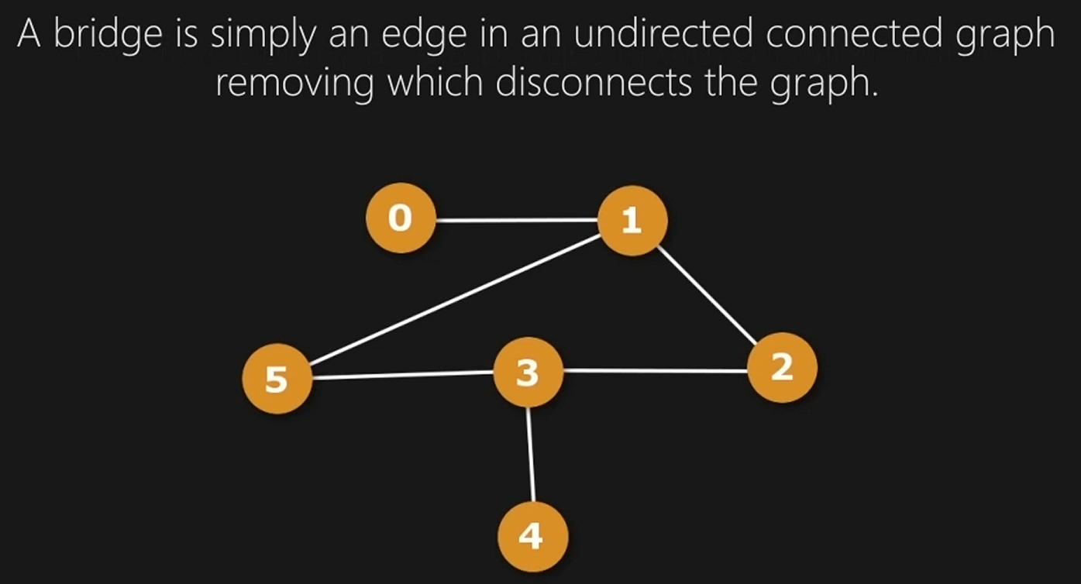
How to Find Bridges

Slide 32
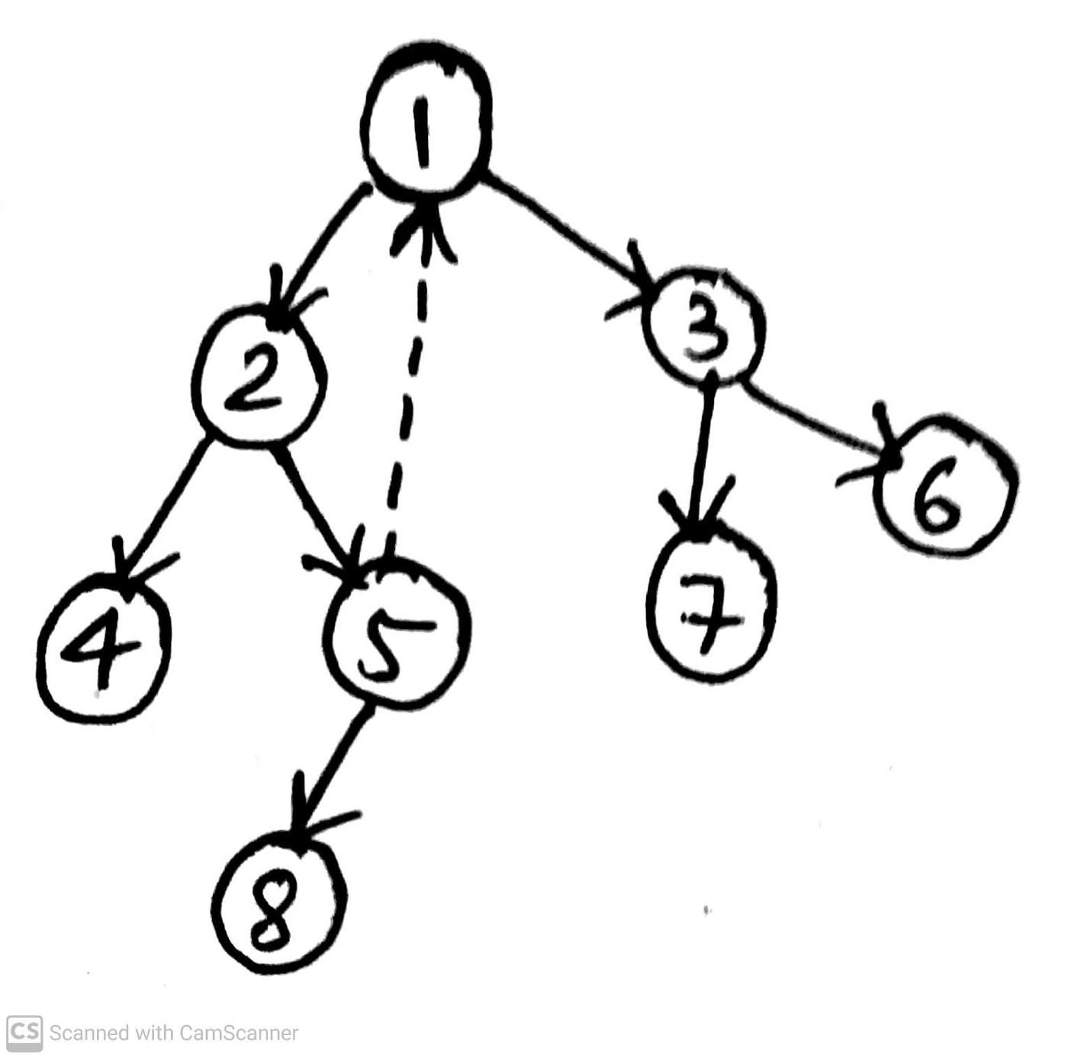
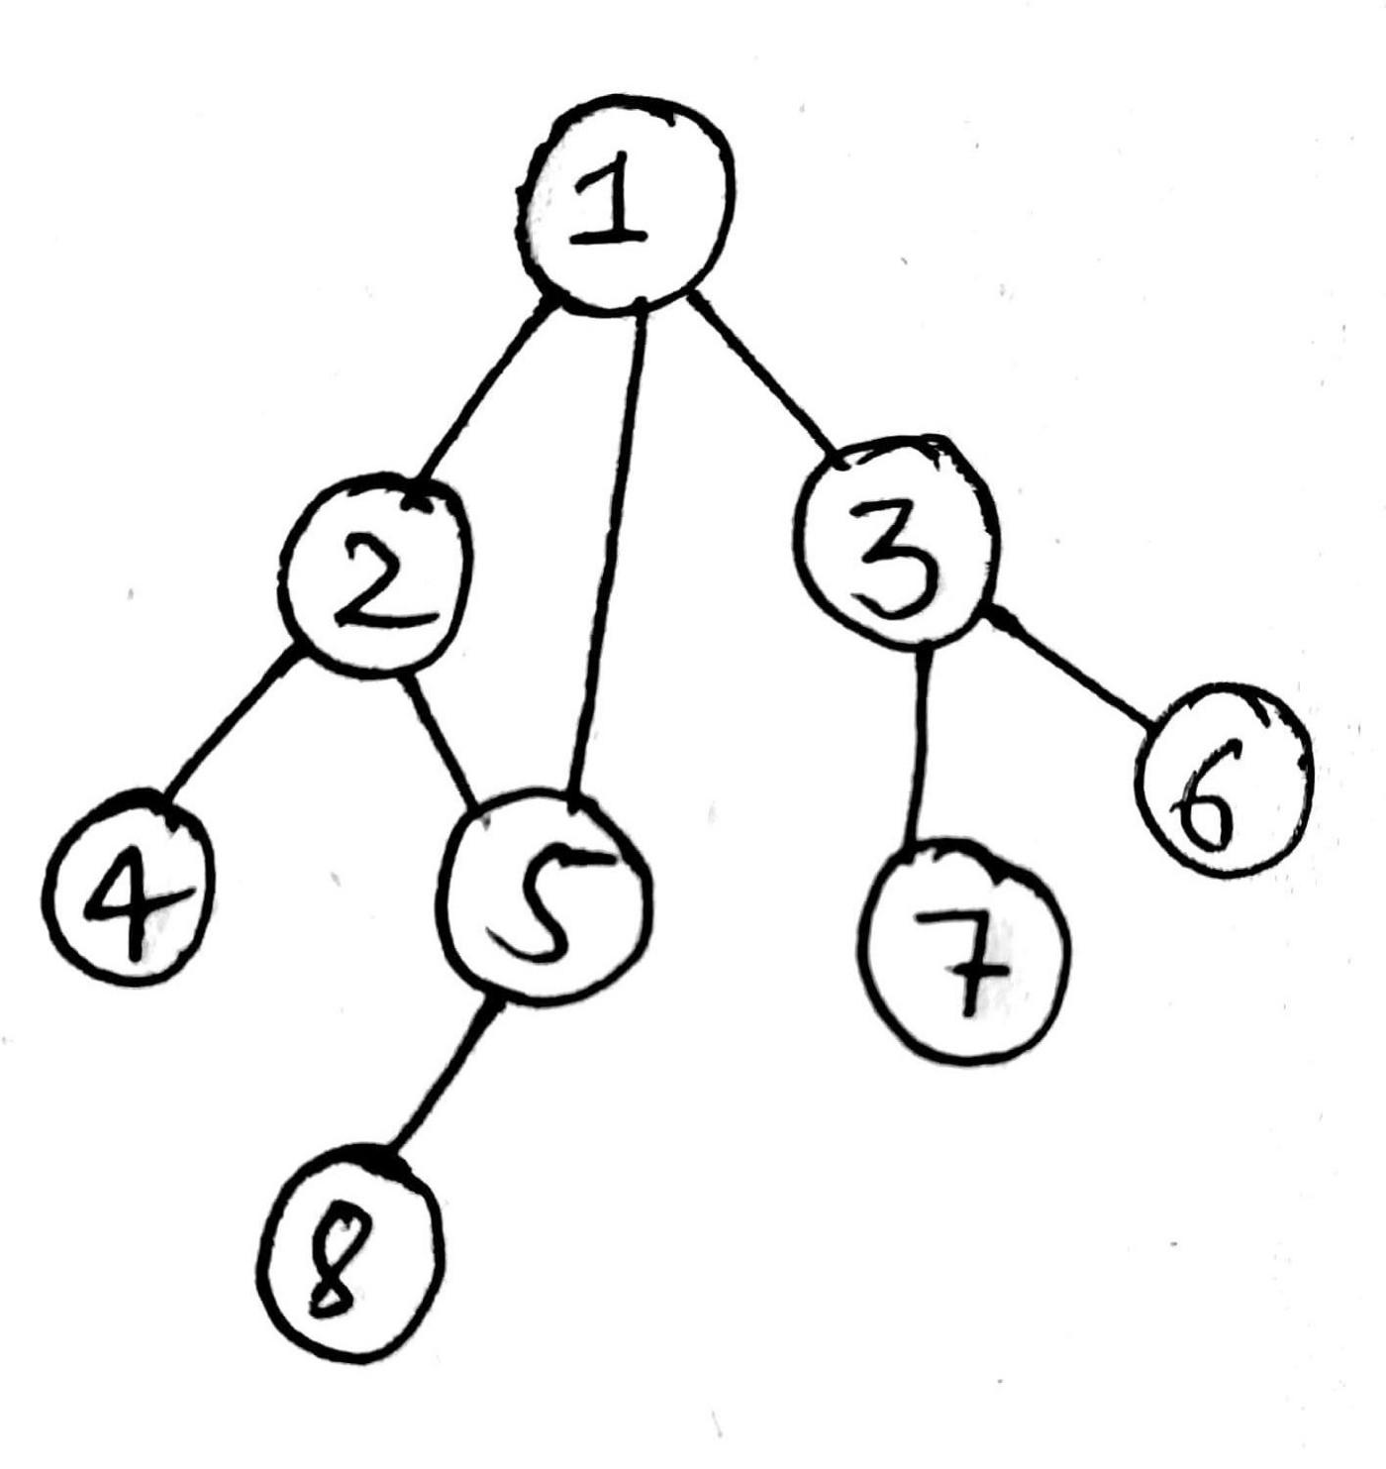

Slide 33
Bridge: Pseudocode
DFS_Visit(v)
{ color[v]=GREY; time=time+1; d[v] = time;
low[v]= d[v];
for each w ∈ Adj[v]{
if(color[w] == WHITE){
prev[w]=u;
DFS_Visit(w);
if low[w] > d[v]
record that vertex (v, w) is a bridge (WHY??)
if (low[w] < low[v]) low[v] := low[w];
}
else if w is not the parent of v then
//--- (v,w) is a BACK edge
` if (d[w] < low[v]) low[v] := d[w];
}
color[v] = BLACK; time = time+1; f[v] = time;
}

Slide 34
Source
Mark Allen Weiss – Data Structure and Algorithm Analysis in C
Articulation Point
Exercise:
CLRS – Exercise 22-2

